Slide 1

DXC Digital Explorer
https://digitalexplorer.dxc.com
Industry, technology, client roadmaps and solution knowledge combined
David Stevens
DXC Distinguished Architect Digital Explorer Product Owner & Architect davidstevens@dxc.com
DXC Workplace group

Slide 2




Understand
Shape
Build
Harvest
Offerings
Disruptor
Solution
Industry
Trend
Value Chain
Digital Roadmap
Idea
Client CMO
Technology
Enabler
Enabler
Partners
Notes:
Slide steps through
1. First we need to understand the business drivers and industry direction
2. Through roadmap’s such as the “DXC innovation agenda” and other client discussions we take these and shape against the client’s key strategic programs
3. The agendas call out opportunities for DXC to build solutions for (offerings plus, partners)
4. Solutions are captured and help support the next person following this common path

Slide 3
Understand
Shape
Build
Harvest
Offerings
Disruptor
Solution
Industry
Trend
Value Chain
Digital Roadmap
Idea
Client CMO
Technology
Enabler
Enabler
Partners
Notes:
This approach is common for all our account leadership teams

Slide 4
Notes:
And is repeated EVERYWHERE

Slide 5
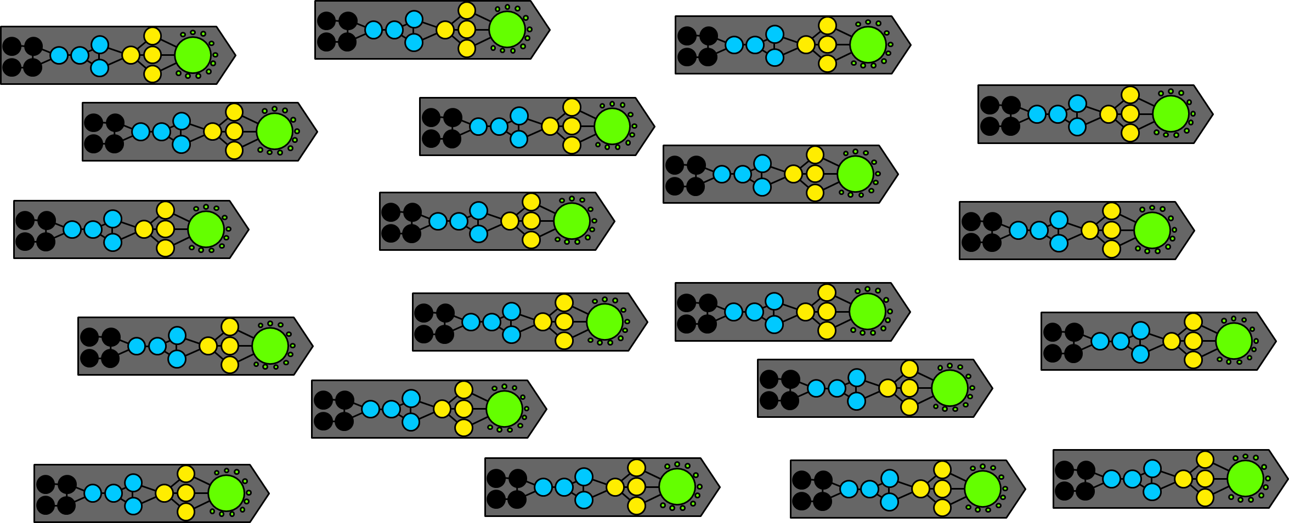
Notes:
Digital Explorer helps connect all these key steps together.
We can all learn and share industry knowledge
We can all understand true client demand and direction
We can work as a single organisation to address the unmet demands
Our Build teams can gain insights into future demand – prep our offerings, people and processes to meet the new demands

Slide 6
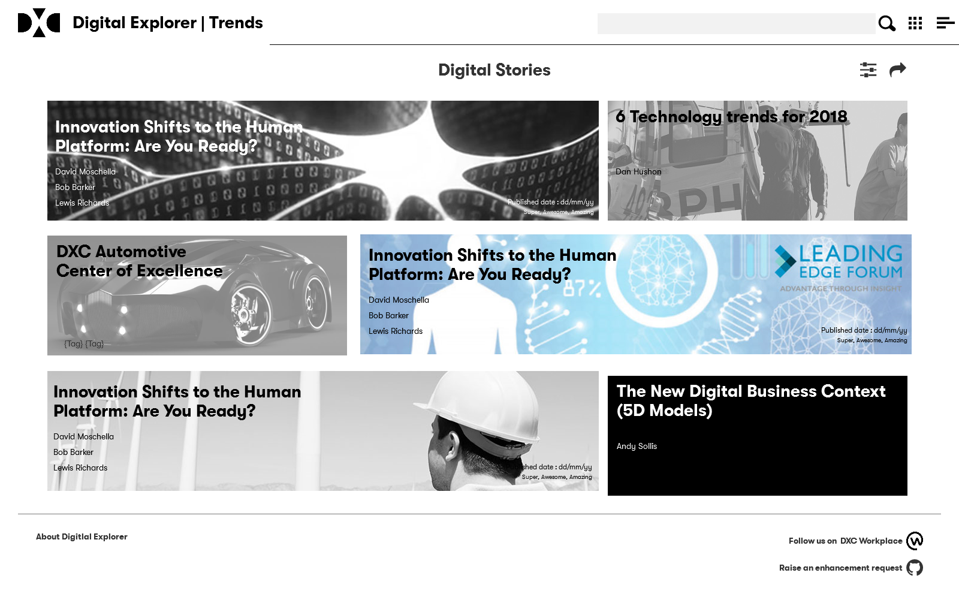
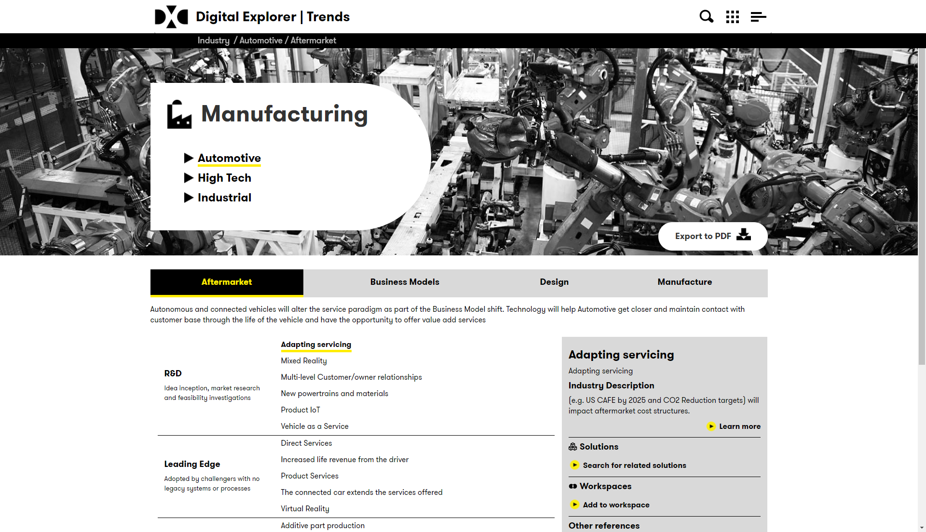
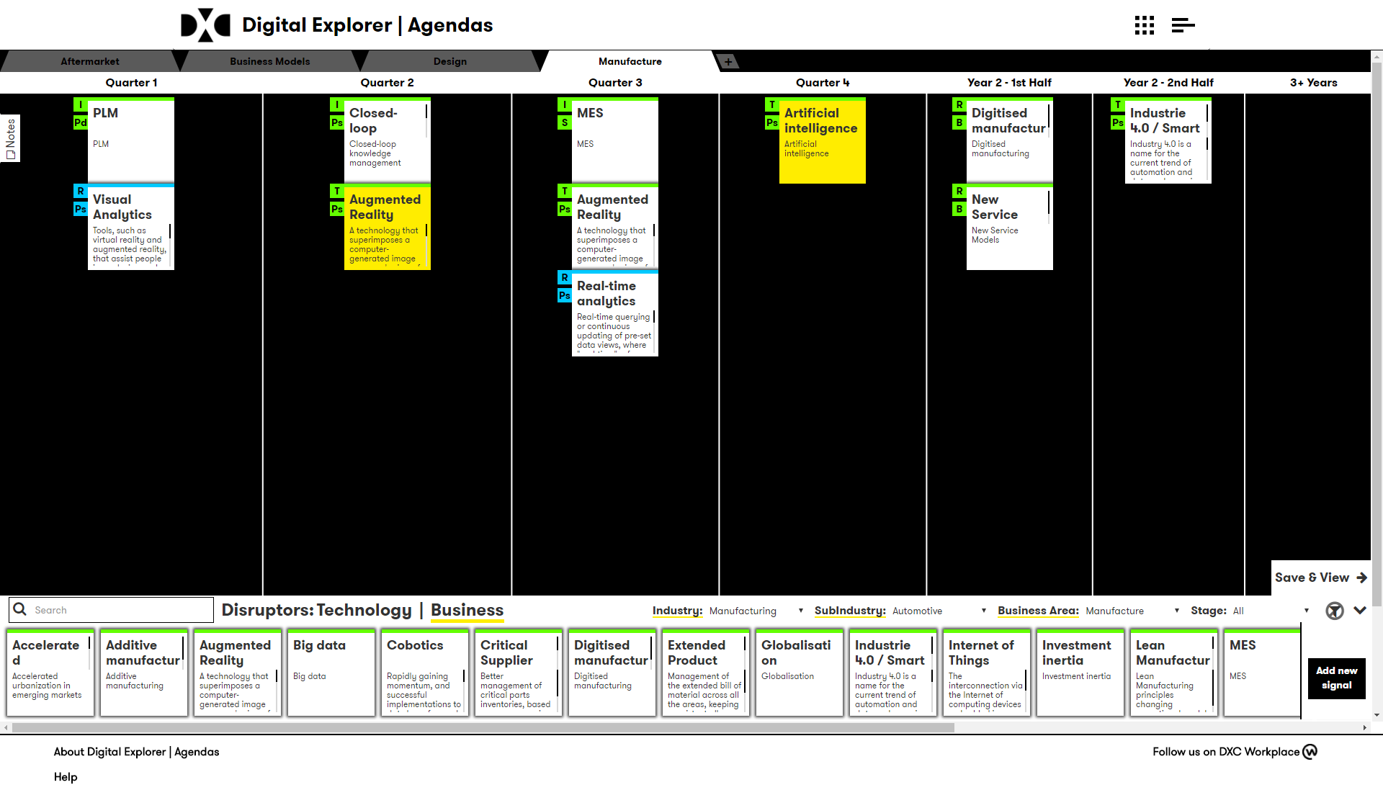
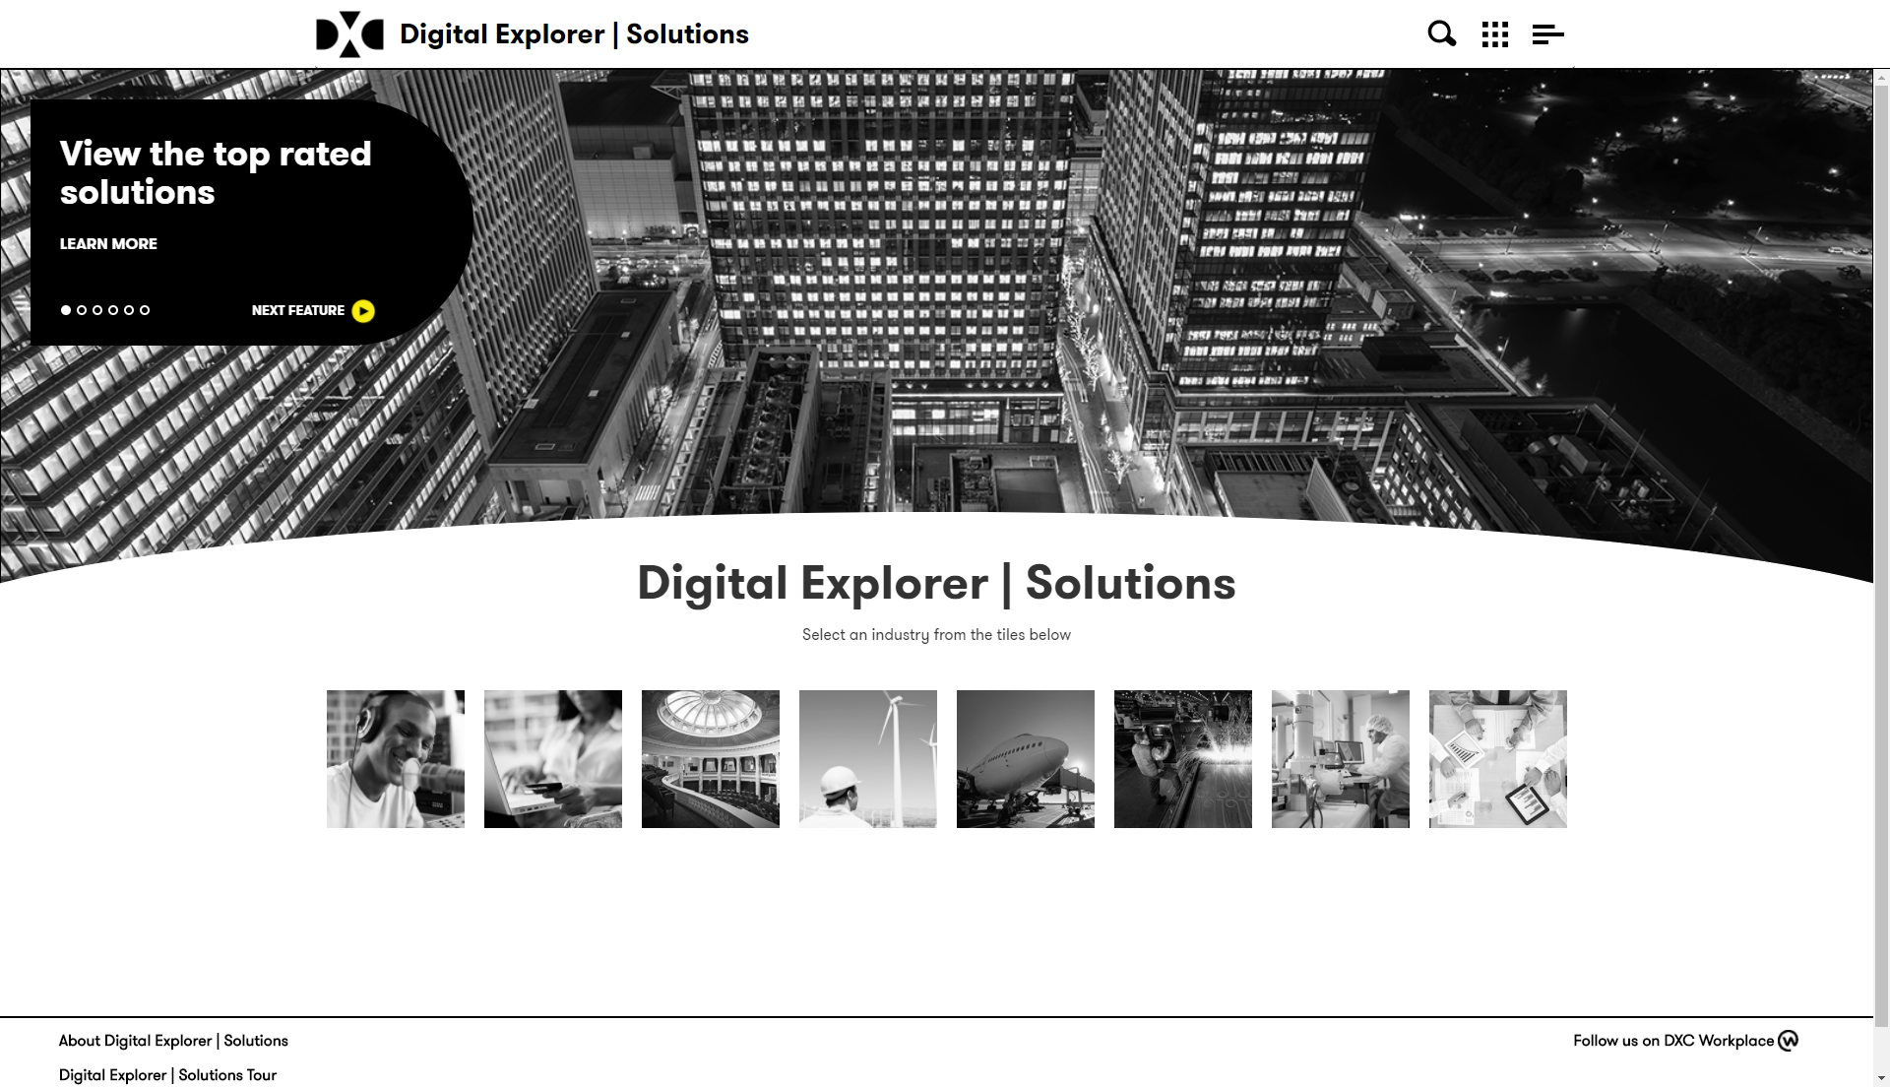

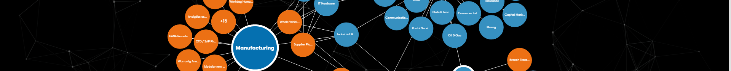
DXC Digital Explorer
DXC Digital Explorer | Stories
DXC Digital Explorer | Trends
DXC Digital Explorer | Roadmaps
DXC Digital Explorer | Solutions
DXC Digital Explorer | Workspaces
Understand
Shape
Deliver
DXC Knowledge Graph

Slide 7
DXC Digital Explorer
Disruptors
& Trends
A single graph knowledge platform to:
Manage & present DXC’s industry knowledge (emerging -> late adaptors)
Manage & present DXC’s offering family trends (emerging -> late adaptors)
Support the client innovation agenda frameworks
Provides a dynamic canvas for account and client teams to build out innovation agenda’s
Map industry and offering trends against client strategic programs
Generate consolidated views and insights against all DXC client innovation agendas
Capture and present DXC’s leading industry solutions
Innovation Agendas
Solutions

Slide 8
Build on collaboration
R&D and invest insights
Build
GET
POR direction
Marketing
Industry Trends
POST
Industry Trends
POST
Technology Trends
POST
Patterns
POST
Industry Insights
DXC Digital Explorer
GET
Summary
Patterns
Sell
GET
Reference Stories
GET
Industry Trends
GET
Operational Efficiency
POST
Client Roadmaps
POST
Solutions
Technology Office
Solutions
Technology Trends
POST
Industry Trends
Deliver
POST
Technology Trends
Client Roadmaps
POST
Emerging Solutions
POST
IP knowledge
GET
Industry Trends
GET
R&D Insights
GET
Operational Efficiency
POST
Solutions

Slide 9
Digital Explorer is the Enterprise Knowledge Graph for DXC
Informing us about the needs of our existing and future clients through the Trends & Agendas modules
Providing Industry views of business and technology trends which help frame conversations with our clients
Digital Roadmaps drive the client towards the right goal
Providing a structured approach to understand the relevant trends and enablers to identify strategic digital projects with the client
Providing DXC outside-in information on demand signals to directly influence the offering IRBs and our partner conversations
Shows evidence of our integrated solutions across build, sell and delivery through the Solutions module.
Solutions can include both internal and partner capabilities

Slide 10
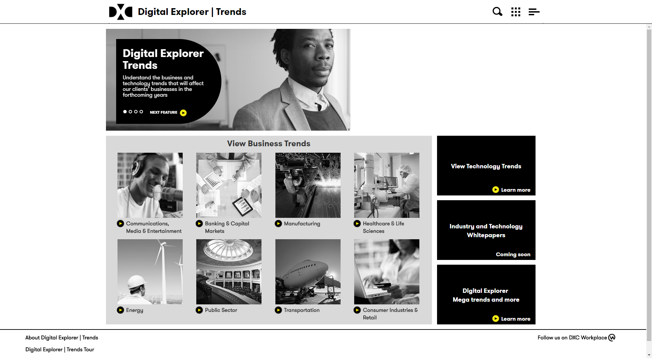
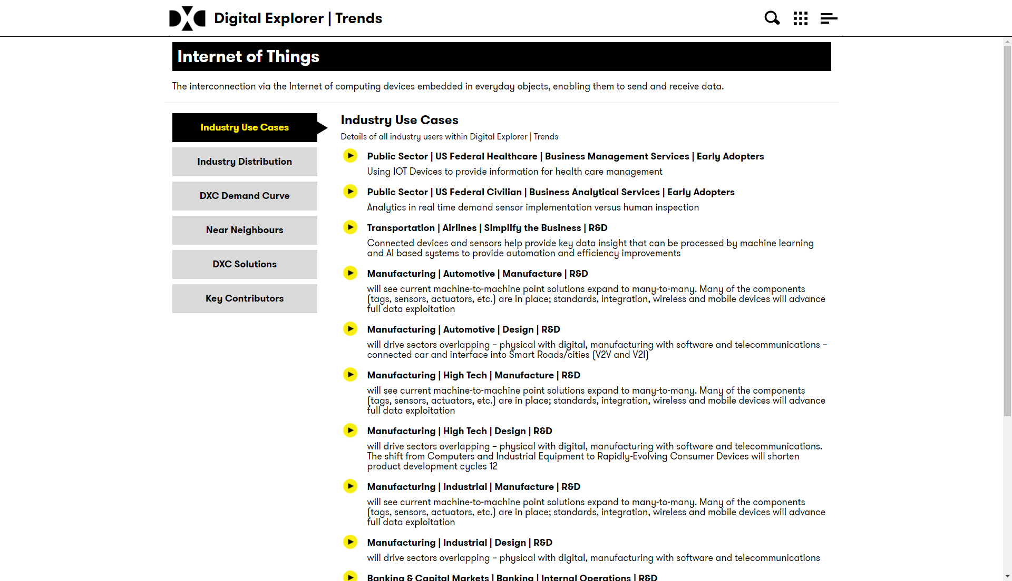
Understand : Industry and Technology trends
Industry and technology trends presented in a consistent way:
Industry > Sub Industry > Business Area > Trend
Trends mapped against the XTECH timeline (R&D, leading edge, early adopters, mainstream, late adopters)
Understand cross industry references
Ability to search for potential solutions
Open collaboration module for all DXC employees
Option to export to PDF

Slide 11
Trends : Key features
Industry Trends | Key industry use cases mapped out against a maturity model, grouped by a set of common areas across all industries - ability to build cross relationships between industries | Link
Technology Trends | Key technology trends mapped out against a maturity model - grouped by technology areas | Link
Open collaboration | Add/edit trends is open to all DXC employees | Link
Digital Stories | Quick links and highlights from within Digital Explorer and external sources (key trends, showcase solutions, relevant papers) | Link
Trend on a page view | Consolidated view of a single trend - industry use cases, demand curve, solutions, contributions (trends and solutions) | Example Link
Achievements | Various Achievements available; 1st, 5th and 10th Trends, industry and technology achievements

Slide 12
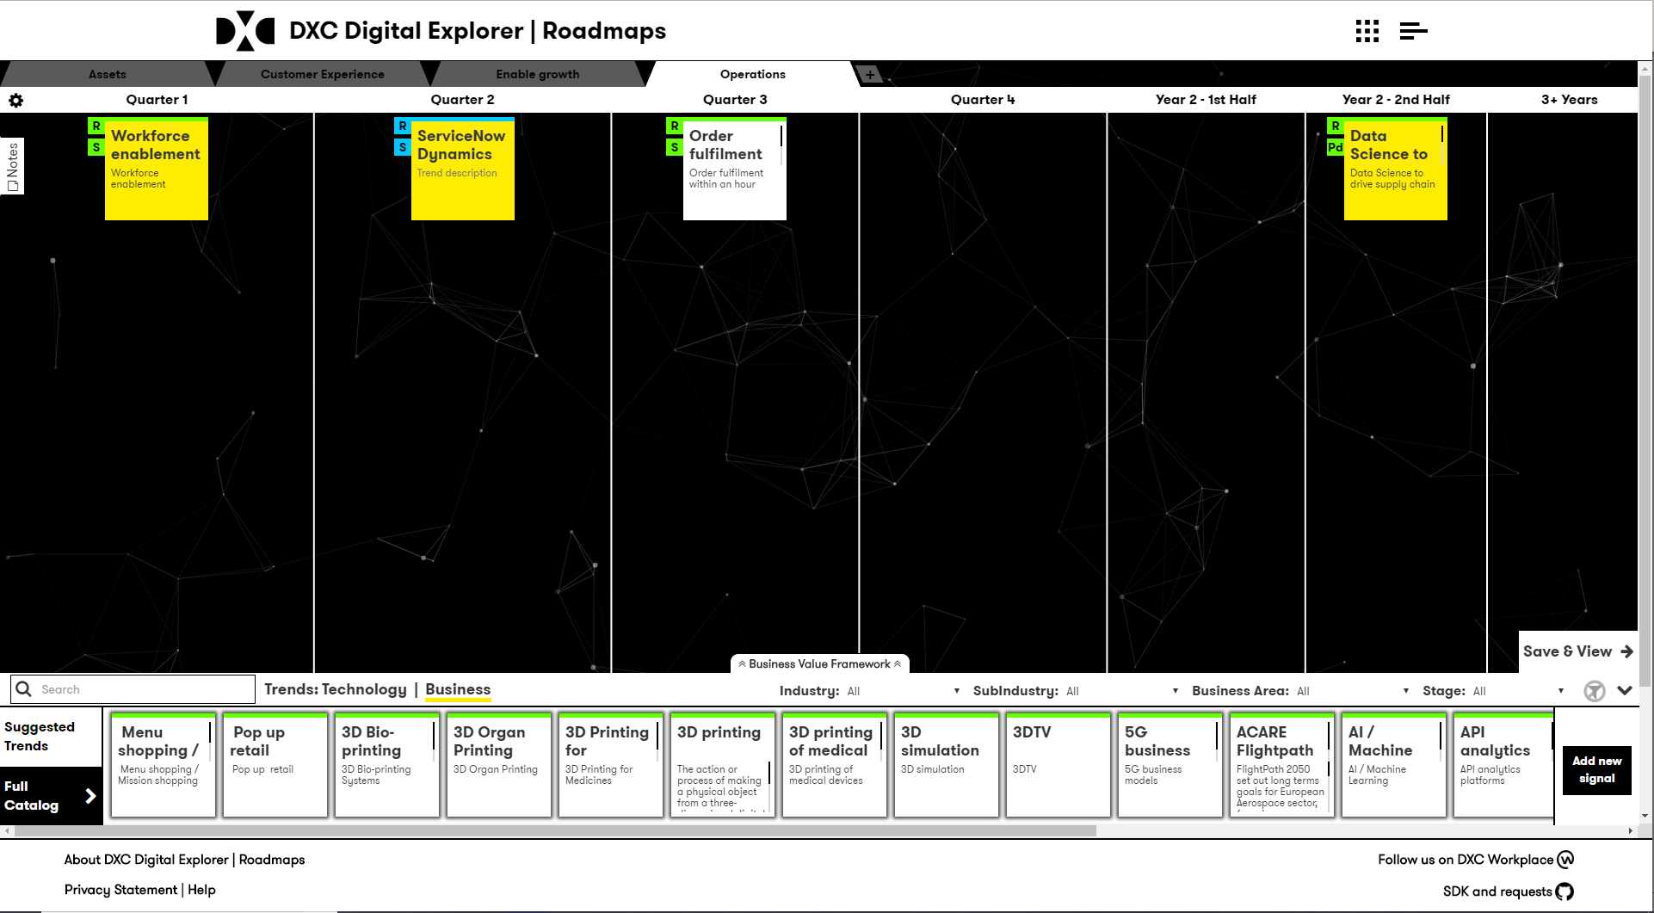
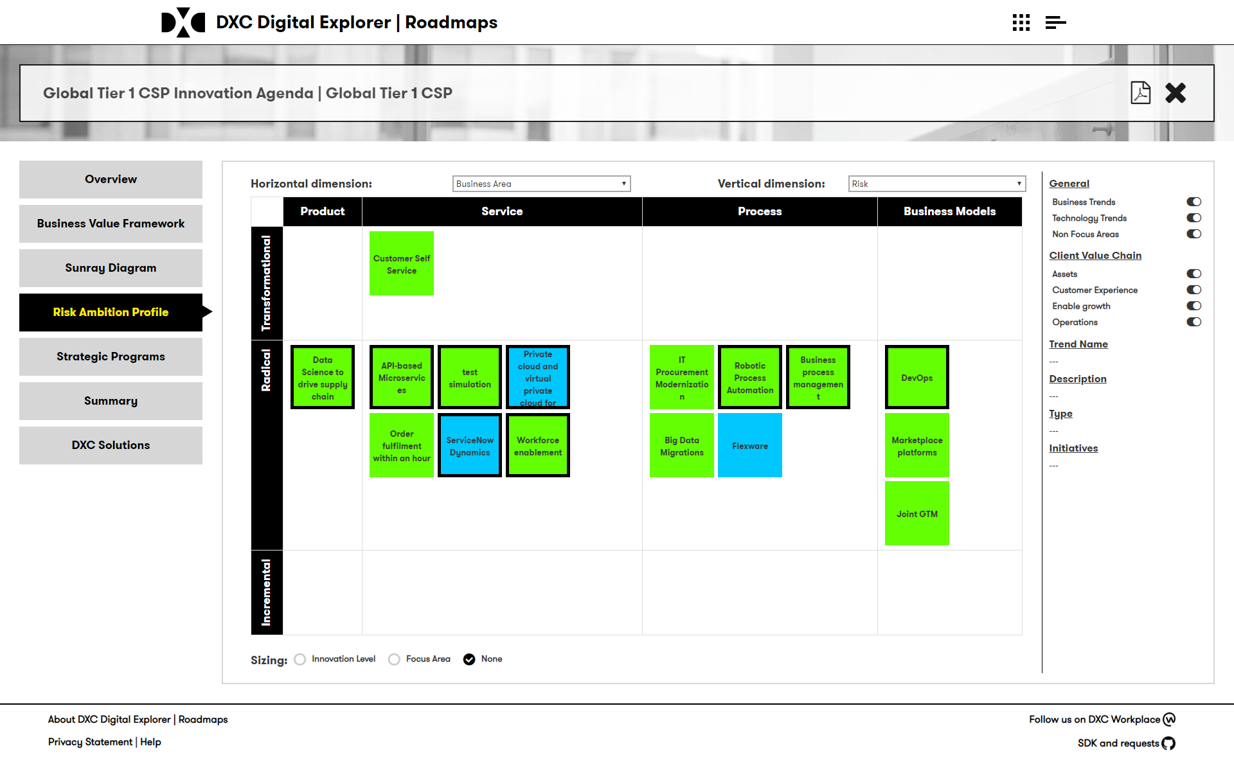
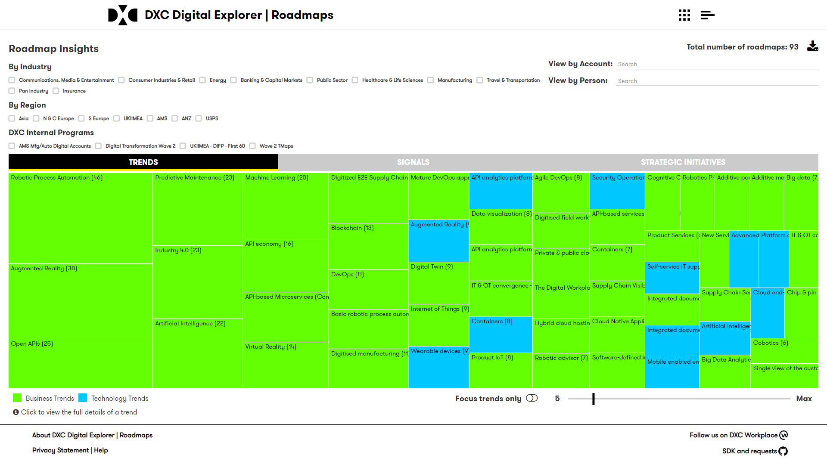
Shape : Roadmaps
Canvas to shape and create account Digital Roadmaps (T-Maps, Innovation Agendas)
Leverage industry and technology knowledge
Identify client and DXC focus areas
Discover matching DXC Solutions and Reference Architectures
Consolidate and report across all accounts
In the application or export to your own reporting tool

Slide 13
Roadmaps : Key features
Internal Programs and groups | Ability to create internal groups to assign accounts - track progress of the creation of the innovation agendas - filter by industry or region
Industry templates | Allow users to create and re-use any available templates for their client innovation agendas
Client Strategic goals | Capture client strategic goals as they relate to the innovation agenda (incs KPI's)
Client disruptors, focus areas, risk and innovation levels | Ability to capture key information about each entry within the Sunray diagram and how they impact the client
Recommendation engine | Smart look-up for similar disruptors from all other innovation agendas - filter by industry or region
Innovation Sunray diagram | Interactive creation and presentation of the innovation sunray diagram (sometime referred to as the T-Map)
Account focus areas | Final output of the innovation agenda - selection of focus disruptors and the definition of the account's strategic initiatives (planned connect the related client goals as well)
DXC Solutions | Dynamic list of available DXC solution based on the disruptors within the innovation agenda
Export to PDF | Export innovation agenda to PDF file
Agenda Insights | Heatmap reports across all Agendas (group by region or industry)
Achievements | 3 achievements available (1st roadmap, helping hands (create a template), taking the next steps (capture ideas)
Role : Agenda Manager | Internal role - assign people to accounts, create internal program groups and review all agendas within the system

Slide 14
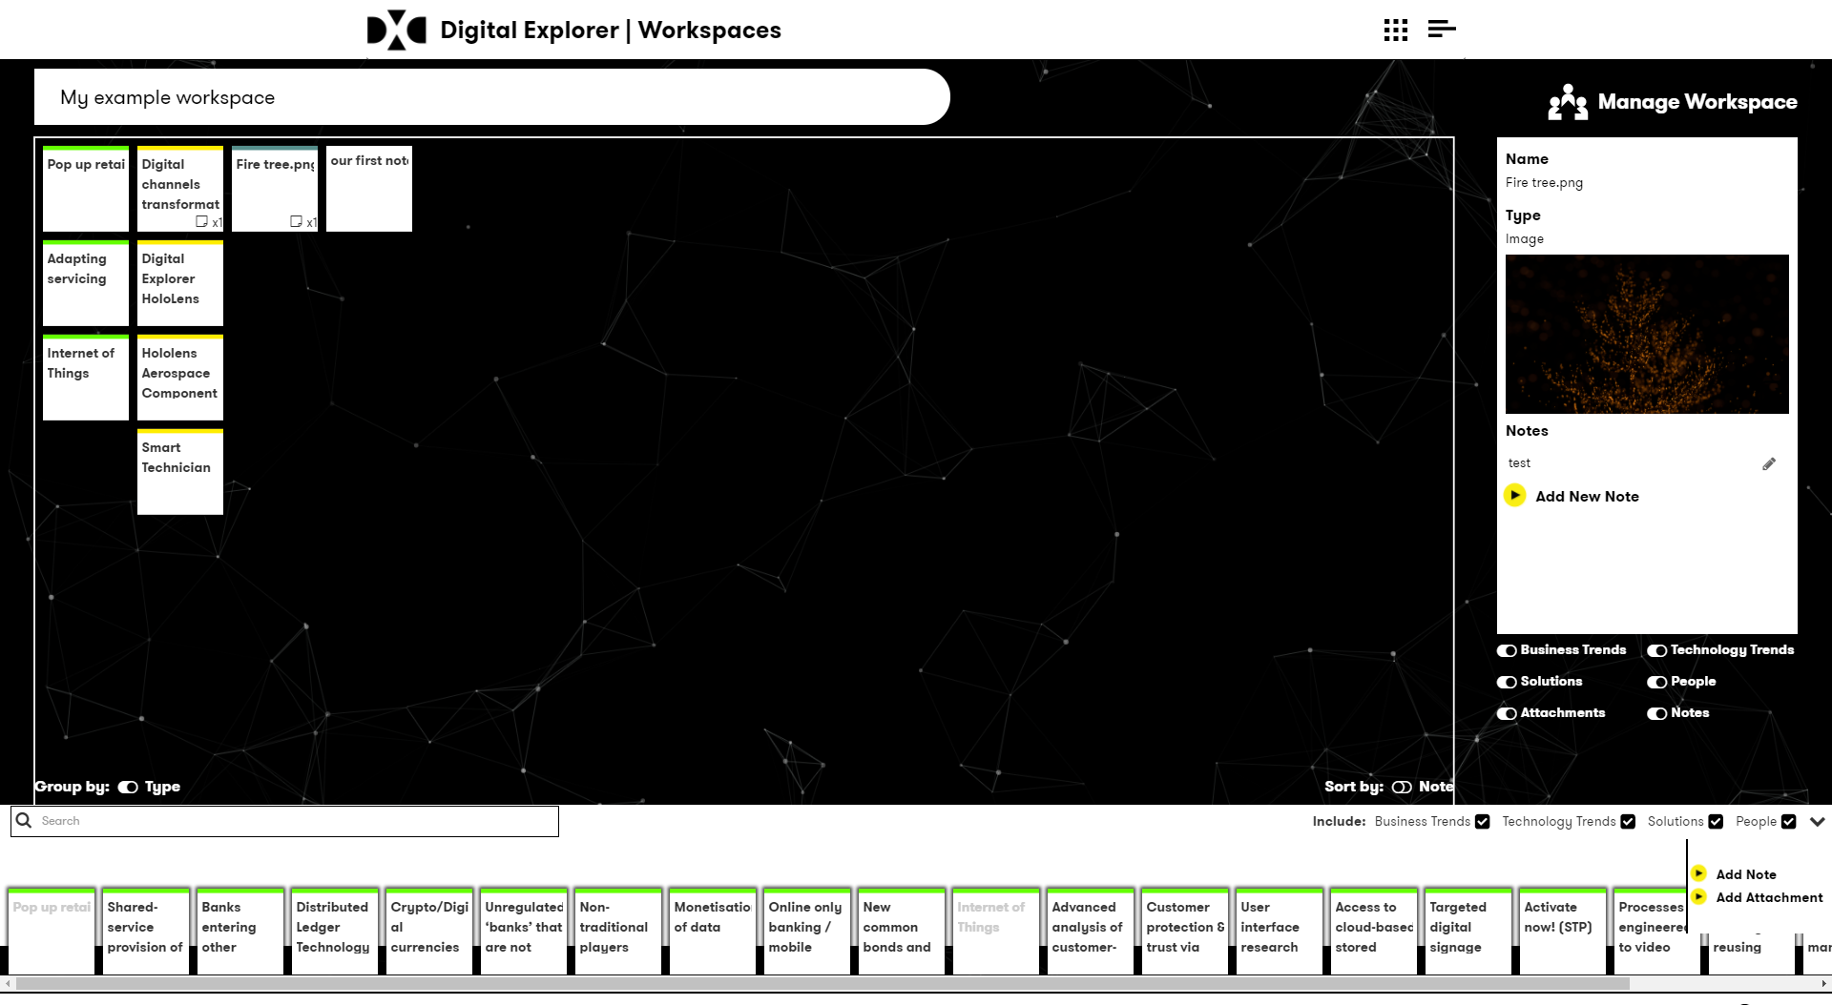
Shape : Workspaces
Collaborate and build project or engagement workspaces leveraging content from across the Digital Explorer platform
Add notes and attachments
Share and invite your team

Slide 15
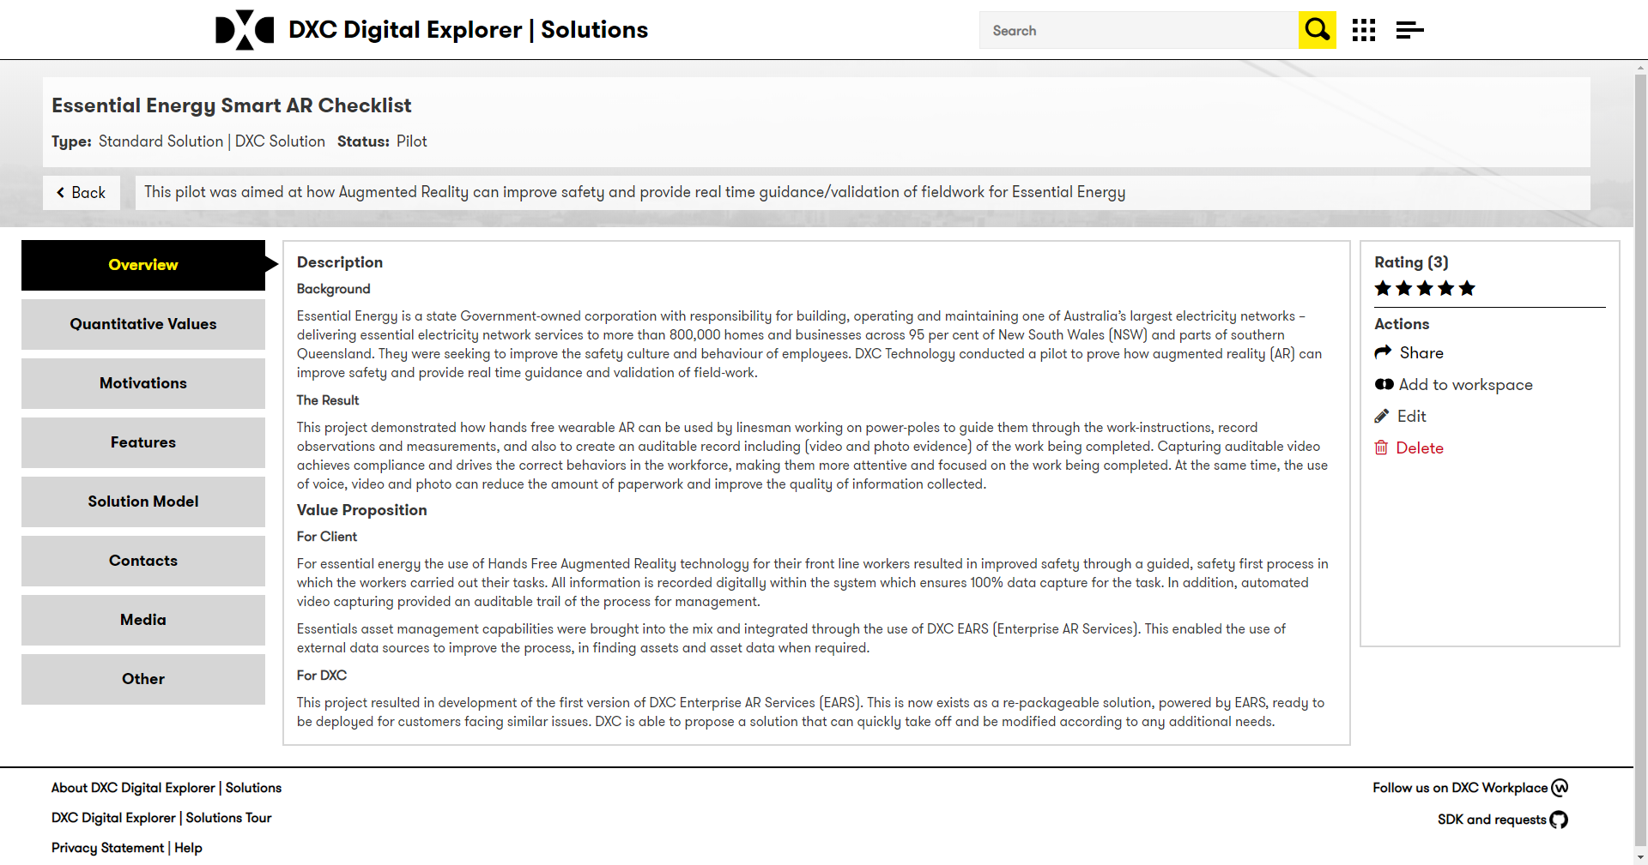
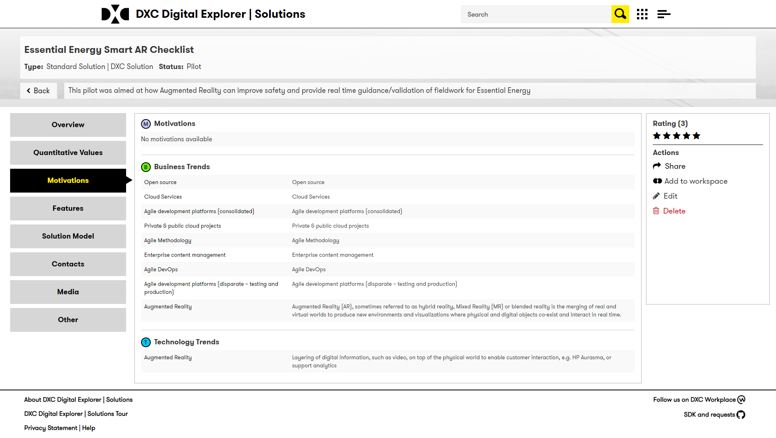
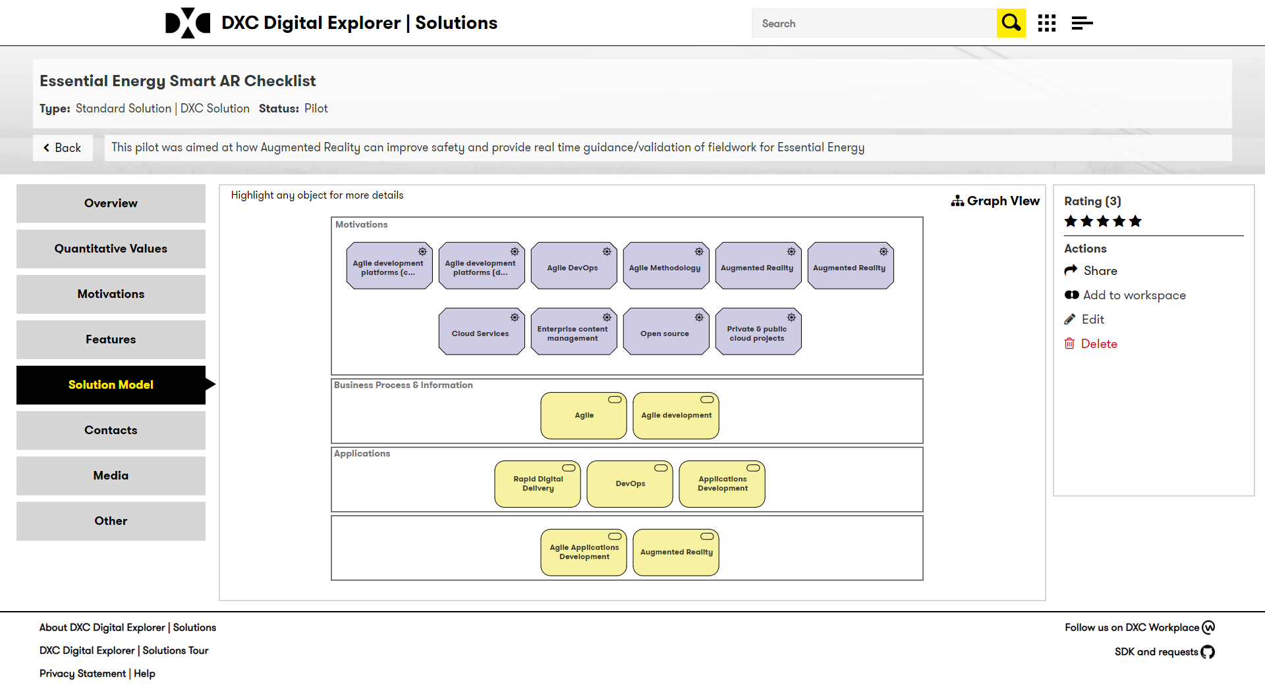
Digital Explorer | Solutions
Model aligned to Archimate 2.1
Each solution presented against a common datasheet and taxonomy:
Model based representation
Architecture views
Supports Reference Architectures and Solution definitions
Build connections to the business and technology trends
Define solutions from a library of existing features
Include documentation & media
Solution Contacts
Industry and offering family information

Slide 16
Solution : Key features
Solution Types | Ability to create various types of solutions (demos, prototypes, pilot, labs, production)
Business Motivations | Highest level within the solution model, smart look-up into "trends" (business and technology) and option to create new motivations
DXC Offering | Ability to specify which DXC offerings (sub-offering level) are part of the solution
Partner capabilities | Ability to specify which partner capabilities are part of the solution
methods | Ability to specify which methods were used to develop/deliver the solution (e.g. Agile)
Other Features | Ability to specify any other features within the solution (e.g. datasets, opensource components)
Roles | Define the team and their roles within the solution
media and attachments | Option to add any supporting media to the solution
Tags | Free form tags to allow users to group or identify solutions (e.g. "Tech Excellence Winners 2018")
Achievements | Various Achievements available; 1st Solution, industry achievements, partner achievements, innovator achievements
Role : Solution Reviewer | Internal Role - data quality reports and ability to edit any solution

Slide 17
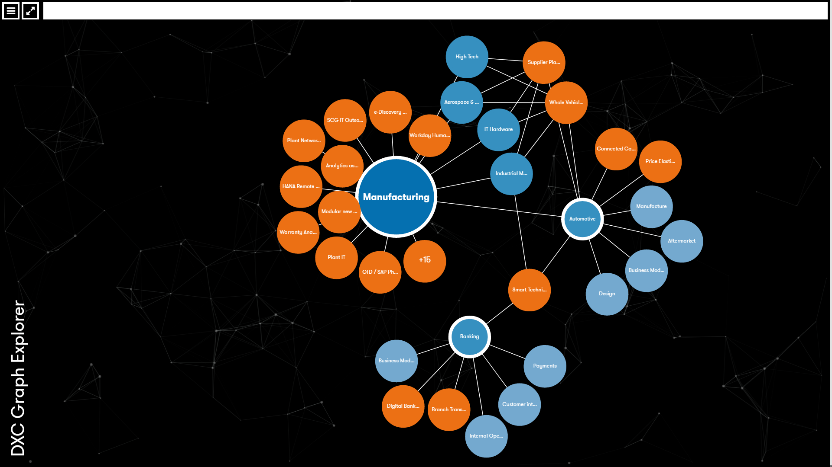
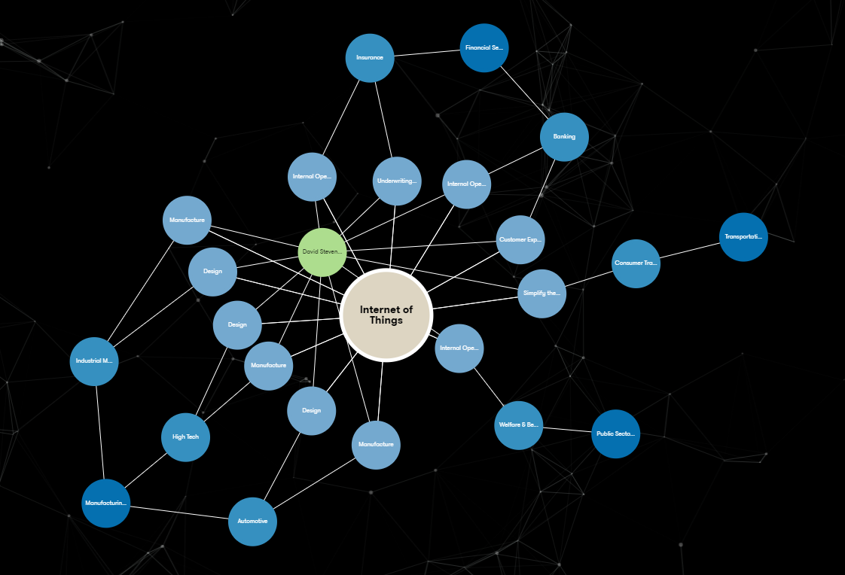
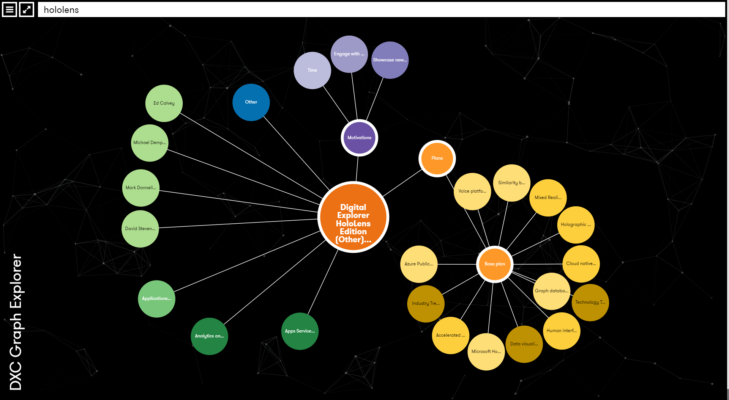
Explore : Graph Explorer
1
Visually rich application to view trend and solution information
Show relationships between solutions, trends and industries ⁽¹⁾
Show disruptor information across industries ⁽²⁾
Group by industry, technology groups or offerings families
Understand the depth of knowledge of our people ⁽³⁾
View the most connected trends
2
3

Slide 18
More Information
DXC Digital Explorer Site
DXC Digital Explorer TV – overview, training and release videos
DXC Workplace group – general discussions
DXC GitHub – issues and enhancement requests

